Slide 1



Parameter Identification in Market-Consistent Calibrations of the Stochastic Volatility Jump Diffusion (SVJD) Equity Model
Purpose:
Investigating the redundancy of the SVJD model and defining the redundant parameters we use in the SVJD model.
Presenter: Yaojiuwei (Roger) Cai

Slide 2
Content
Background
1
Simulating Real Market Data
Stochastic Volatility Jump diffusion Model (SVJD)
2
Heston Stochastic Differential Equation
Merton Jump Stochastic Differential Equation
Market Consistent Calibration (MC)
3
ESG
How do we get the volatility value?
Data Analysis
4
ESG
Data structure
Data Sensitivity and normalised volatility analysis
Notes:
4pt | Flags | Flag | Choice | Direction

Slide 3
1
2
3
4
Background
Notes:
In today’s world, stochastic future projection is becoming a very popular tool to investigate the future variation of some uncertain things.
The one we might familiar is called Black Schole’s model, this mathematical equation estimates the theoretical value of derivatives based on other investment instruments, and the pricing result is considered to be the standard market assumption by scientists.
It has some good affect to the development of the science, but as the market is changing all the time, and cannot be predicted in a certain way. Along the way that the digital finance is becoming easier to access, people discovered that the real market data feature is less align with the model predicted ones.

Slide 4
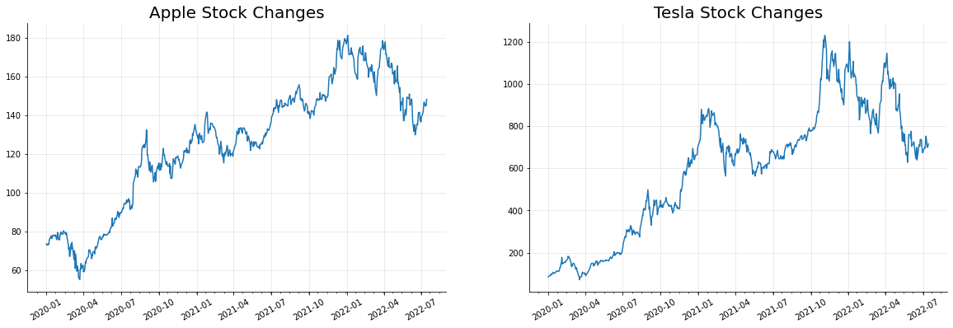
The Real Market Data for Apple and Tesla from Jan 2020 to July 2022
Plots are generated by using the data from Yahoo Finance

Slide 5
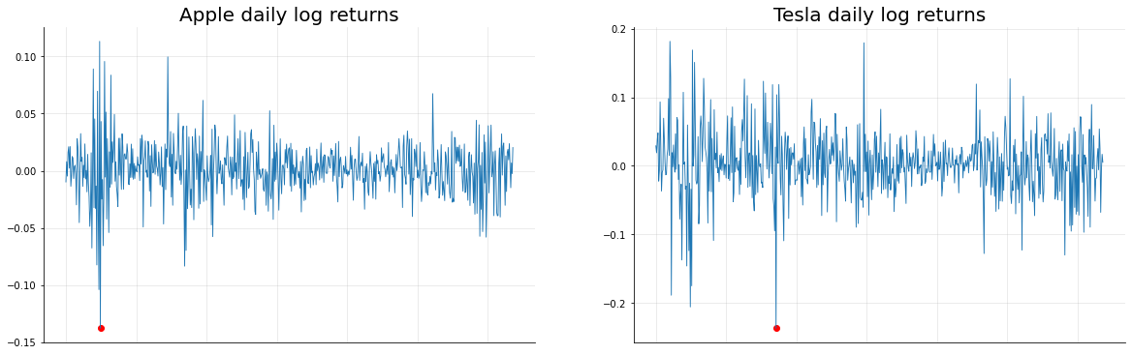
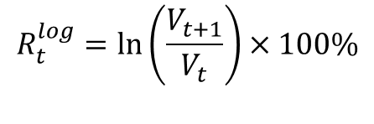
$$R_{t}^{log}=\ln\left(\frac{V_{t+1}}{V_{t}}\right)×100\%$$
The Log Return of Apple and Tesla Stocks from Jan 2020 to July 2022
Plots are generated by using the data from Yahoo Finance

Slide 6
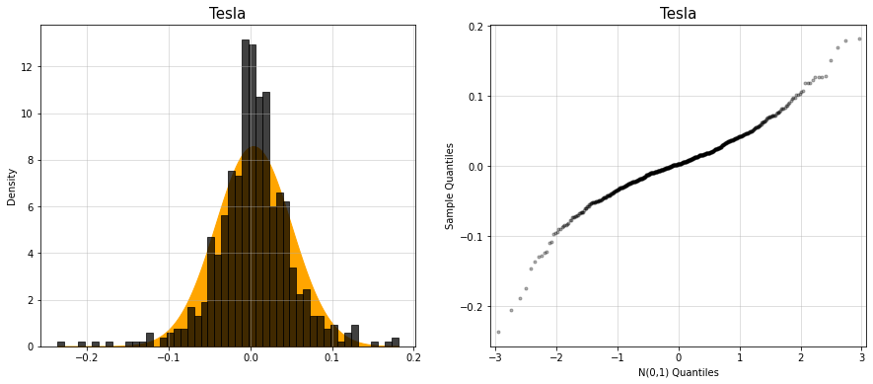
The Log Return of Apple and Tesla Stocks from Jan 2020 to July 2022
Plots are generated by using the data from Yahoo Finance

Slide 7
2
3
4
Stochastic Volatility Jump Diffusion Model
(SVJD)
Notes:
Form this name, you might be curious and might want to ask me, we normally have Stochastic volatility and Stochastic jump model, but this model contained both names in it, does it mean it has both model’s features? And the answer is yes!

Slide 8
SVJD
H
1
Heston Stochastic Differential equation
Stochastic Volatility Jump Diffusion Model (SVJD)
Merton Jump Stochastic Differential equation
M
2

Slide 9
High Peak
The Log Return of Apple and Tesla Stocks from Jan 2020 to July 2022
Plots are generated by using the data from Yahoo Finance

Slide 10

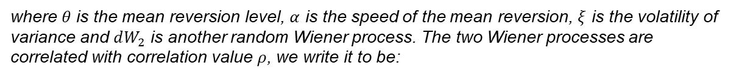
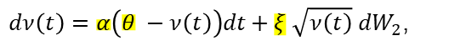
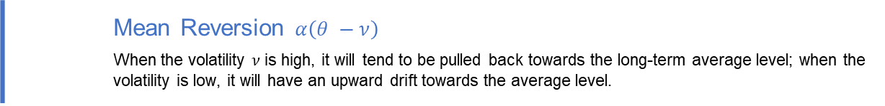
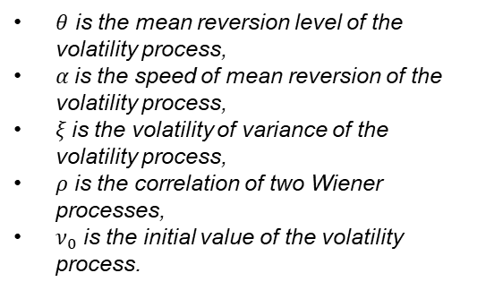
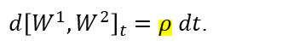
Heston Stochastic Differential equation
The log excess stock price $\ln\left(S^{XS}\right)$ follows both a continuous and dis continuous process. The continuous process is a standard Heston stochastic volatility model,
$dlnS^{SV}\left(t\right)=\left(μ − \frac{ν\left(t\right)}{2}\right)dt+\sqrt{ν\left(t\right)} dW_{1}$,
where $μ$ is the risk premium, which vanishes in the risk neutral world, and $dW_{1}$ is a random Wiener process. The variance process $ν$ follows a Cox-Ingersoll-Ross process:
$dν\left(t\right)=α\left(θ −ν\left(t\right)\right)dt+ξ \sqrt{ν\left(t\right)} dW_{2}$,
$θ$ is the mean reversion level of the volatility process,
$α$is the speed of mean reversion of the volatility process,
$ξ$is the volatility of variance of the volatility process,
$ρ$ is the correlation of two Wiener processes,
$ν_{0}$ is the initial value of the volatility process.
where $θ$ is the mean reversion level, $α$ is the speed of the mean reversion, $ξ$ is the volatility of variance and $dW_{2}$ is another random Wiener process. The two Wiener processes are correlated with correlation value $ρ$, we write it to be:
$d{\left[W^{1},W^{2}\right]}_{t}=ρ dt$.
 | Mean Reversion $α\left(θ −ν\right)$ When the volatility $ν$ is high, it will tend to be pulled back towards the long-term average level; when the volatility is low, it will have an upward drift towards the average level.

Slide 11
Fat Tails
The Log Return of Apple and Tesla Stocks from Jan 2020 to July 2022
Plots are generated by using the data from Yahoo Finance

Slide 12
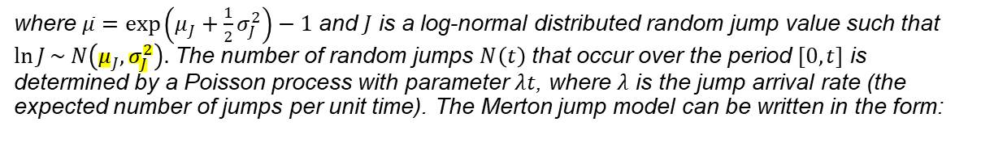
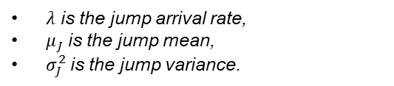
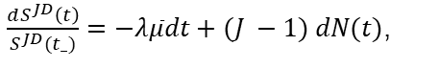
Merton Jump Stochastic Differential equations
The discontinuous process is a Merton jump model:
$dlnS^{JD}\left(t\right)=−λ\overline{μ}dt+ln⁡(J) dN(t)$, where $dN\left(t\right)=N\left(t+dt\right)−N(t)$
where $\overline{μ}=\exp\left(μ_{J}+\frac{1}{2}σ_{J}^{2}\right)−1$ and $J$ is a log-normal distributed random jump value such that $\ln{J}\sim N\left(μ_{J}, σ_{J}^{2}\right).$ The number of random jumps $N\left(t\right)$ that occur over the period $[0,t]$ is determined by a Poisson process with parameter $λt$, where $λ$ is the jump arrival rate (the expected number of jumps per unit time). The Merton jump model can be written in the form:
$λ$ is the jump arrival rate,
$μ_{J}$is the jump mean,
$σ_{J}^{2}$is the jump variance.
$\frac{dS^{JD}\left(t\right)}{S^{JD}(t_)}=−λ\overline{μ}dt+(J −1) dN(t)$,
where $S^{JD}\left(t_\right)=\lim_{t→t_}{S^{JD}(t)}$.

Slide 13
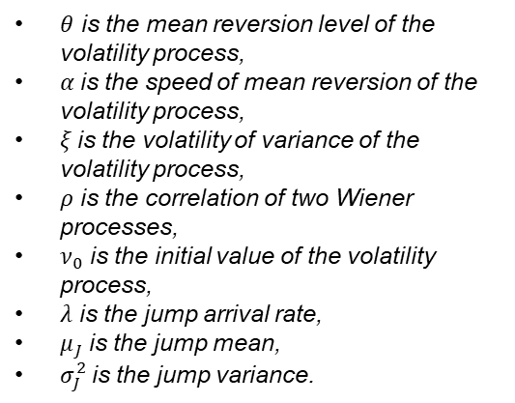
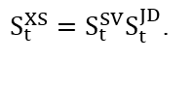
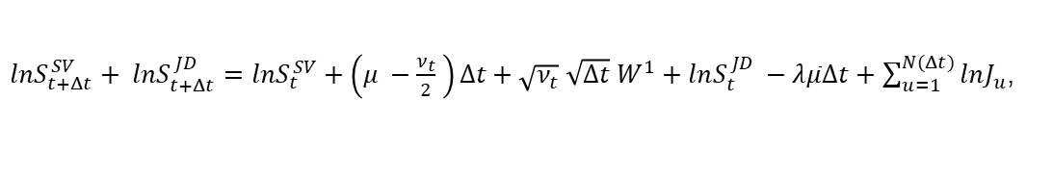
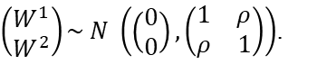
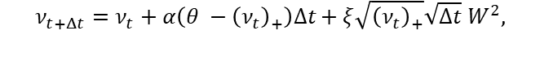
Stochastic Volatility Jump Diffusion Model
The model equation:
$lnS_{t+Δt}^{SV}+ lnS_{t+Δt}^{JD}=lnS_{t}^{SV}+\left(μ −\frac{ν_{t}}{2} \right)Δt+\sqrt{ν_{t}} \sqrt{Δt} W^{1}+lnS_{t}^{JD} −λ\overline{μ}Δt+$ $\sum_{u=1}^{N(Δt)}{lnJ_{u}}$,
and
$$ν_{t+Δt}=ν_{t}+α\left(θ −{\left(ν_{t}\right)}_{+}\right)Δt+ξ\sqrt{{\left(ν_{t}\right)}_{+}}\sqrt{Δt} W^{2},$$
with
$θ$ is the mean reversion level of the volatility process,
$α$is the speed of mean reversion of the volatility process,
$ξ$is the volatility of variance of the volatility process,
$ρ$ is the correlation of two Wiener processes,
$ν_{0}$ is the initial value of the volatility process,
$λ$ is the jump arrival rate,
$μ_{J}$is the jump mean,
$σ_{J}^{2}$is the jump variance.
$\left(\begin{matrix}W^{1} \\ W^{2}\end{matrix}\right)\sim N \left(\begin{matrix}\left(\begin{matrix}0 \\ 0\end{matrix}\right), \left(\begin{matrix}1 & ρ \\ ρ & 1\end{matrix}\right)\end{matrix}\right)$.
Finally, let $S_{t}^{XS}$ be the combined process, we have:
$S_{t}^{XS}=S_{t}^{SV}S_{t}^{JD}$.

Slide 14
3
4
Market Consistent Calibration (MC)
Notes:
Form this name, you might be curious and might want to ask me, we normally have Stochastic volatility and Stochastic jump model, but this model contained both names in it, does it mean it has both model’s features? And the answer is yes!

Slide 15

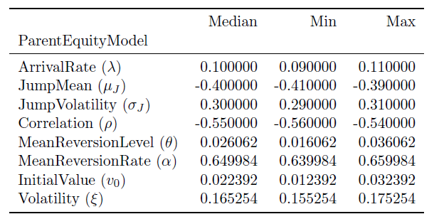

Calibration Process
Calibration
1. Pseudo Market Prices
2. Levenberg-Marquardt Optimiser
3. Price convert to
Implied Volatility(IV)
Random selected SVJD model
parameters’ values
Black-Scholes best
estimate
Option price under
16 Maturities
11 Strikes
16 Maturities: 0.25, 0.50, 0.75, 1.00, 2.00, 3.00, 4.00, 5.00, 6.00, 7.00, 8.00, 9.00, 10.00, 15.00, 20.00, 25.00
11 Strikes: 0.5, 0.6, 0.7, 0.8, 0.9, 1.0, 1.1, 1.2, 1.3, 1.4, 1.5
Manager
COS Pricing
method
 | Market Consistent Calibration It is defined as finding a unique set of model parameters that provide a good description of the system behaviour. In the project, the optimised parameters will help us to generate the model produced data to be as similar as the one we see in the real market.
Notes:
Here, we have

Slide 16
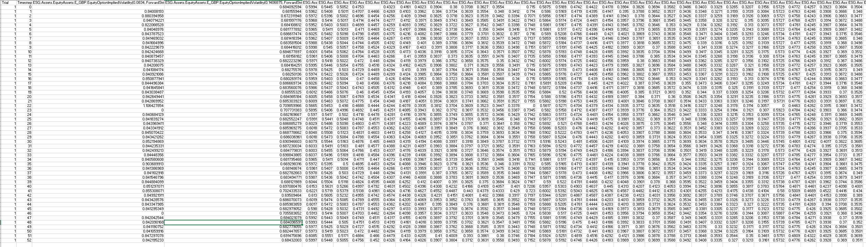
Data from Economic Scenario Generator:

Slide 17
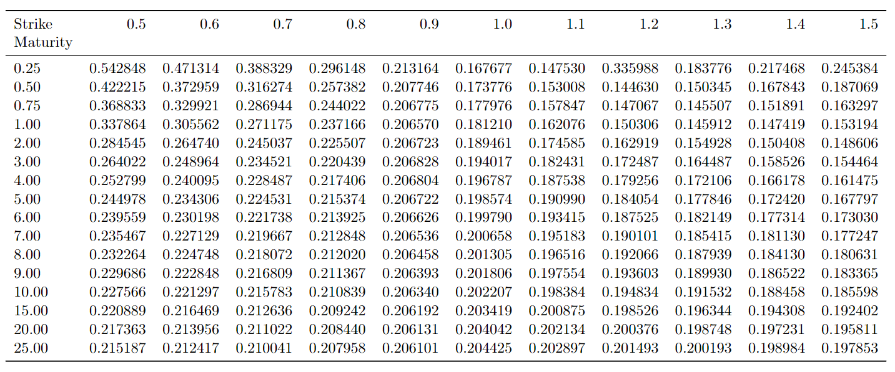
Python sorted data output:

Slide 18

 | Fourier Cosine Expansion Method (COS Method) It is the method that the calibration process use to generate the price of the option. Show in the OneNote if have time.

Slide 19
4
Data Analysis
Notes:
Form this name, you might be curious and might want to ask me, we normally have Stochastic volatility and Stochastic jump model, but this model contained both names in it, does it mean it has both model’s features? And the answer is yes!

Slide 20
Data Analysing
1. Data Structure
2. Conclusion
24 matrices generated by ESG
There are 8 parameters, and each parameter has 3 files
9,328 volatilities of combination of 16 Maturities and 11 Strikes
- Volatility Smile visualisation
3. Parameter redundancy Part I
4. Parameter redundancy Part II
Sensitivity check
Data normalisation
Data visualisation
Conclusion
Linear Regression Model
Conclusion
Notes:
4pt | Circle | Line | Line | Circle | Choice

Slide 21
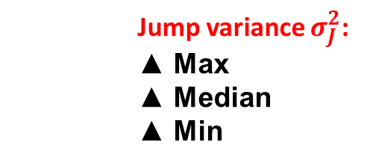
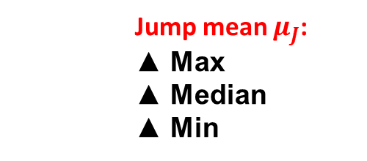
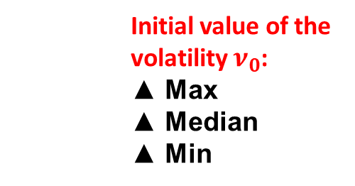
1. Data Structure
24 matrices generated by ESG
Correlation 𝜌:
▲ Max
▲ Median
▲ Min
Mean reversion level 𝜃:
▲ Max
▲ Median
▲ Min
Speed of mean reversion 𝛼:
▲ Max
▲ Median
▲ Min
Volatility 𝜉:
▲ Max
▲ Median
▲ Min
Initial value of the volatility $ν_{0}$:
▲ Max
▲ Median
▲ Min
Jump arrival rate 𝜆:
▲ Max
▲ Median
▲ Min
Jump mean $μ_{J}$:
▲ Max
▲ Median
▲ Min
Jump variance $σ_{J}^{2}$:
▲ Max
▲ Median
▲ Min
Notes:
Here, we have

Slide 22
Correlation 𝜌:
▲ Max
▲ Median
▲ Min
▲ Max
How do we generate this matrix?
Calibration for SVJD model
Option IVs

Slide 23
1. Data Structure
24 matrices generated by ESG
Correlation 𝜌:
▲ Max
▲ Median
▲ Min
Mean reversion level 𝜃:
▲ Max
▲ Median
▲ Min
Speed of mean reversion 𝛼:
▲ Max
▲ Median
▲ Min
Volatility 𝜉:
▲ Max
▲ Median
▲ Min
Initial value of the volatility $ν_{0}$:
▲ Max
▲ Median
▲ Min
Jump arrival rate 𝜆:
▲ Max
▲ Median
▲ Min
Jump mean $μ_{J}$:
▲ Max
▲ Median
▲ Min
Jump variance $σ_{J}^{2}$:
▲ Max
▲ Median
▲ Min
Notes:
Here, we have

Slide 24
Data Analysing
2. Implied Volatility Check
1. Data Structure
24 matrices generated by ESG
There are 8 parameters, and each parameter has 3 files
9,328 volatilities of combination of 16 Maturities and 11 Strikes.
- Volatility Smile visualisation
3. Parameter redundancy Part I
4. Parameter redundancy Part II
Sensitivity check
Data normalisation
Data visualisation
Conclusion
Linear Regression Model
Conclusion
Notes:
4pt | Circle | Line | Line | Circle | Choice

Slide 25
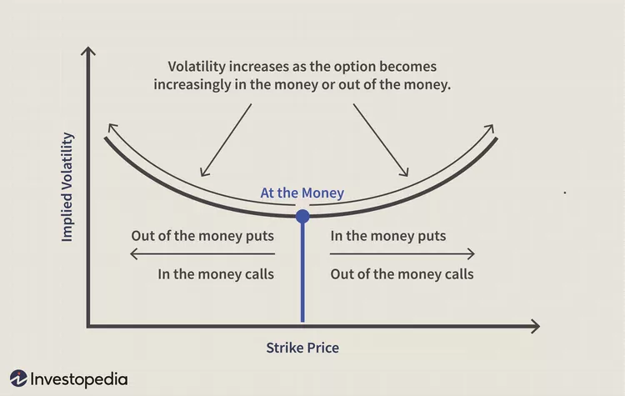
2. Implied Volatility Check
Easy example shown on Investopedia:
Notes:
Here, we have

Slide 26
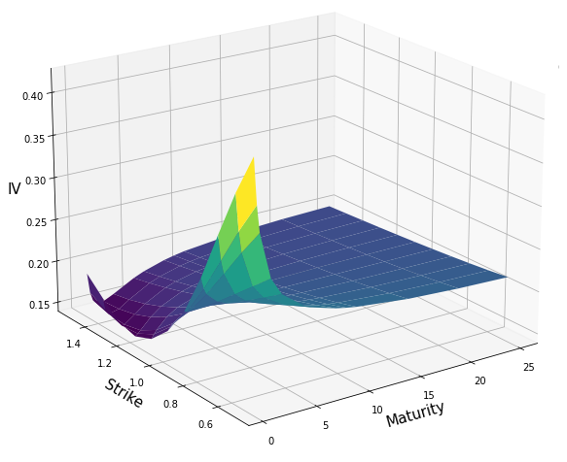

Slide 27
Data Analysing
1. Data Structure
2. Conclusion
24 matrices generated by ESG
There are 8 parameters, and each parameter has 3 files
9,328 volatilities of combination of 16 Maturities and 11 Strikes.
- Volatility Smile visualisation
3. Parameter redundancy Part I
4. Parameter redundancy Part II
Sensitivity check
Data normalisation
Data visualisation
Conclusion
Linear Regression Model
Conclusion
Notes:
4pt | Circle | Line | Line | Circle | Choice

Slide 28
3. Parameter redundancy Part I
Sensitivity check: Difference between ▲ Max and ▲ Median, and difference ▲ Median and ▲ Min.
▲ Max
▲ Max
▲ Median
Redundant parameter
▲ Median
Notes:
Here, we have

Slide 29
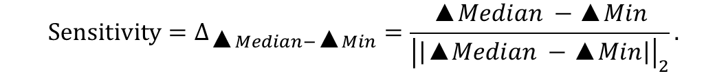
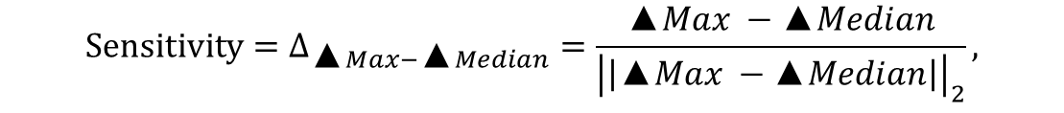
3. Parameter redundancy Part I
Sensitivity check: Difference between ▲ Max and ▲ Median, and difference ▲ Median and ▲ Min.
Data normalisation:
$${Sensitivity=Δ}_{\text{▲}Max−\text{▲}Median}=\frac{\text{▲}Max −\text{▲}Median}{{\left|\left|\text{▲}Max −\text{▲}Median\right|\right|}_{2}},$$
$${Sensitivity=Δ}_{\text{▲}Median−\text{▲}Min}=\frac{\text{▲}Median −\text{▲}Min}{{\left|\left|\text{▲}Median −\text{▲}Min\right|\right|}_{2}}.$$
Notes:
Here, we have

Slide 30
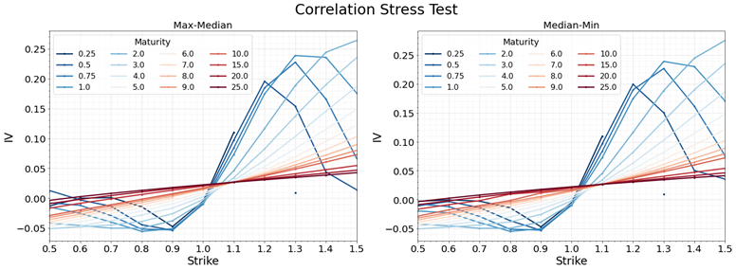
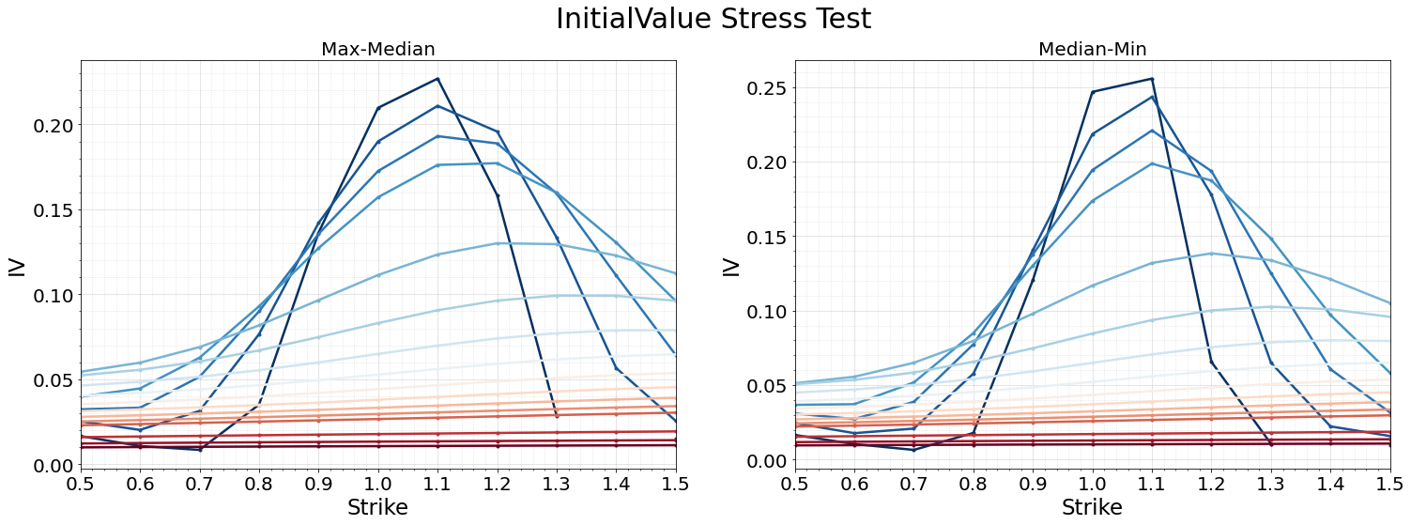
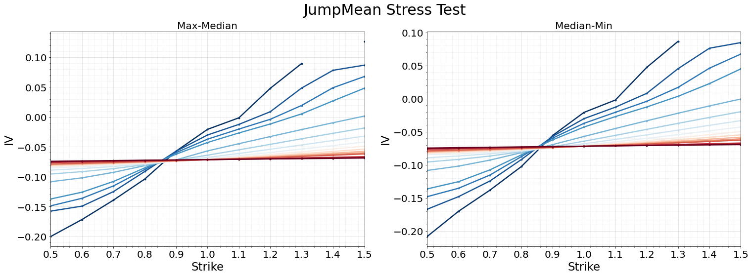
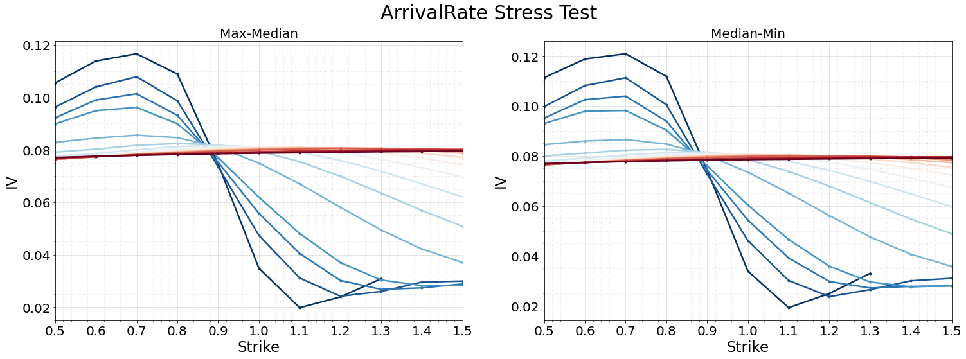
Data Visualisation:
Notes:
Here, we have

Slide 31
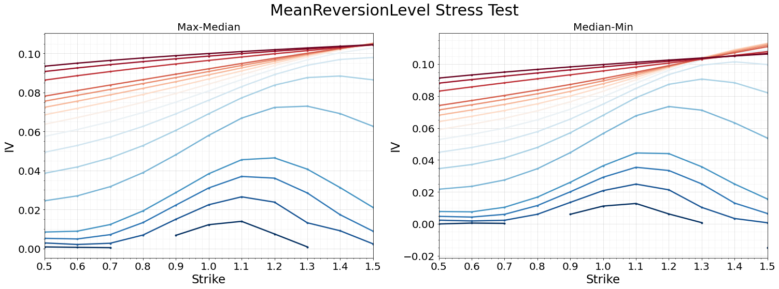
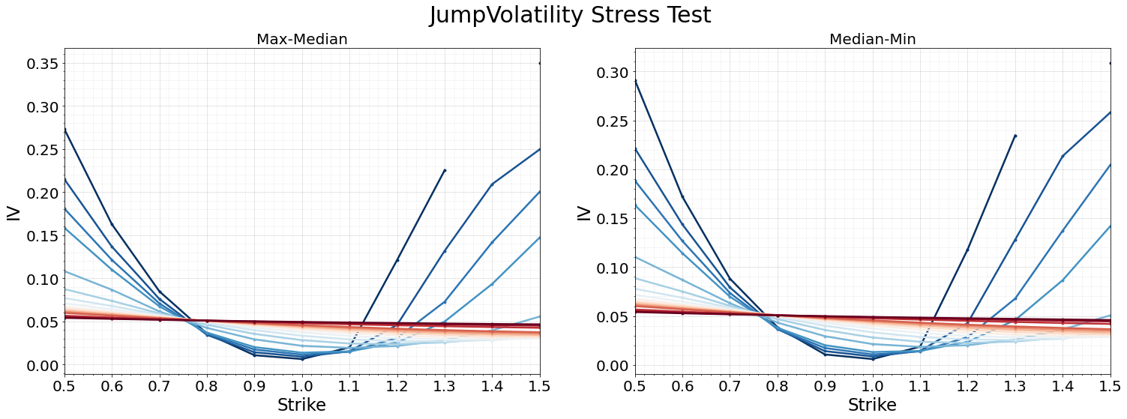
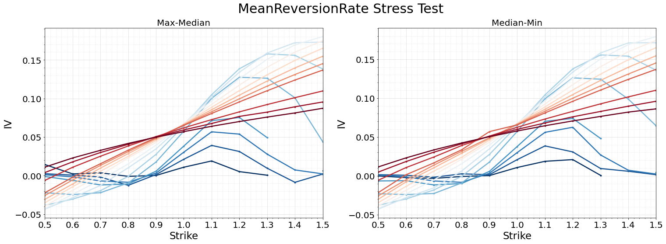
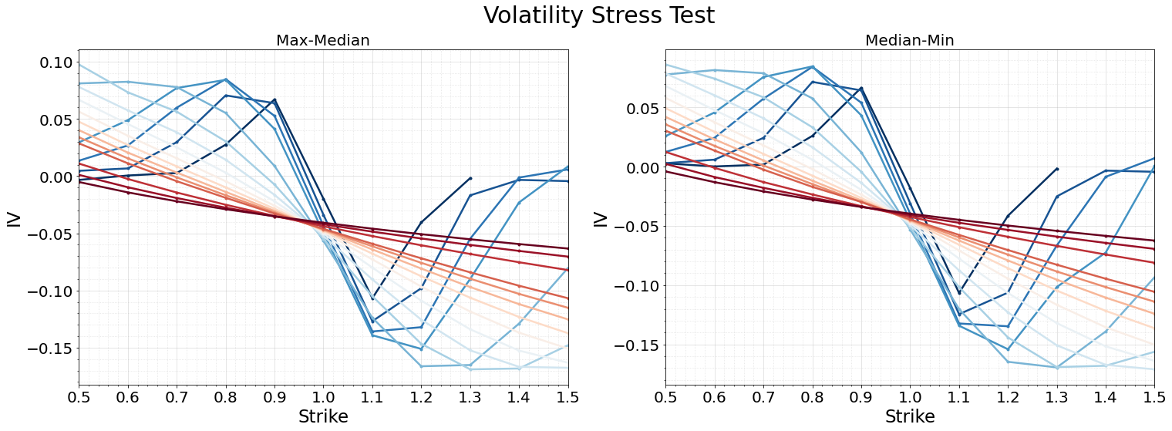
Data Visualisation:
Notes:
Here, we have

Slide 32
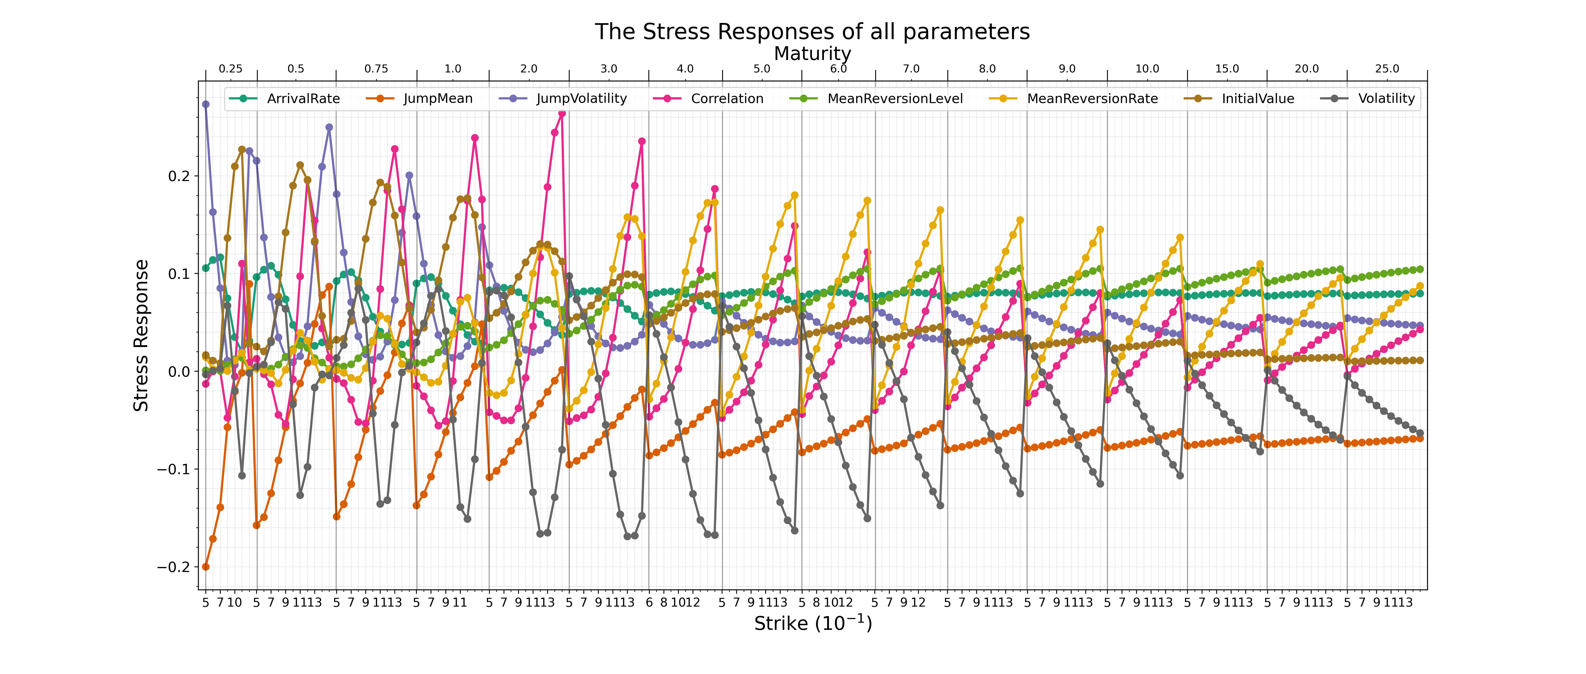
Data Visualisation:

Slide 33
Data Analysing
1. Data Structure
2. Conclusion
24 matrices generated by ESG
There are 8 parameters, and each parameter has 3 files
9,328 volatilities of combination of 16 Maturities and 11 Strikes.
- Volatility Smile visualisation
4. Parameter redundancy Part II
3. Parameter redundancy Part I
Sensitivity check
Data normalisation
Data visualisation
Conclusion
Linear Regression Model
Conclusion
Notes:
4pt | Circle | Line | Line | Circle | Choice

Slide 34
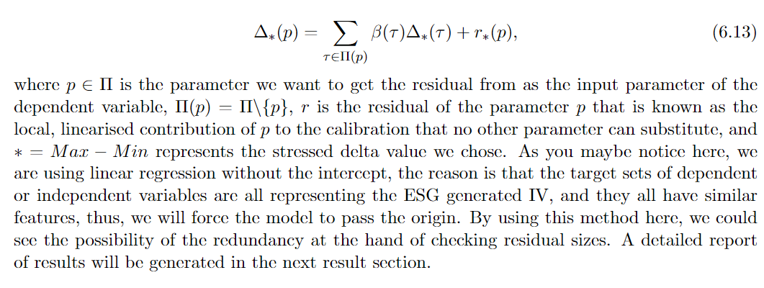
Linear Regression Model:

Slide 35
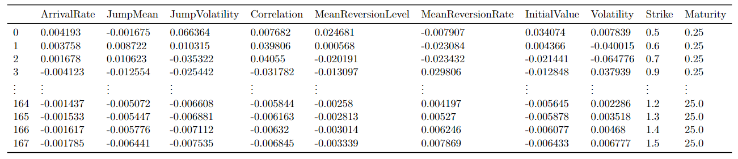
Linear Regression Model:
1
2
3
4
5
6
7
8
$$Δ_{∗}\left(p\right)=β\left(λ\right)Δ_{∗}\left(λ\right)+β\left(θ\right)Δ_{∗}\left(θ\right)+β\left(α\right)Δ_{∗}\left(α\right)+β\left(ξ\right)Δ_{∗}\left(ξ\right)+β\left(ρ\right)Δ_{∗}\left(ρ\right)+β\left(ν_{0}\right)Δ_{∗}\left(ν_{0}\right)+β\left(μ_{J}\right)Δ_{∗}\left(μ_{J}\right)+β\left(σ_{J}^{2}\right)Δ_{∗}\left(σ_{J}^{2}\right)+r_{∗}(p)$$
2
3
4
5
6
7
8
$$Δ_{∗}\left(p\right)=β\left(θ\right)Δ_{∗}\left(θ\right)+β\left(α\right)Δ_{∗}\left(α\right)+β\left(ξ\right)Δ_{∗}\left(ξ\right)+β\left(ρ\right)Δ_{∗}\left(ρ\right)+β\left(ν_{0}\right)Δ_{∗}\left(ν_{0}\right)+β\left(μ_{J}\right)Δ_{∗}\left(μ_{J}\right)+β\left(σ_{J}^{2}\right)Δ_{∗}\left(σ_{J}^{2}\right)+r_{∗}(p)$$

Slide 36
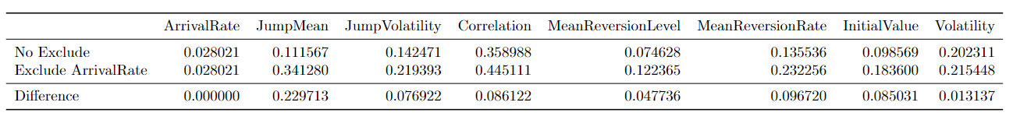

Slide 37
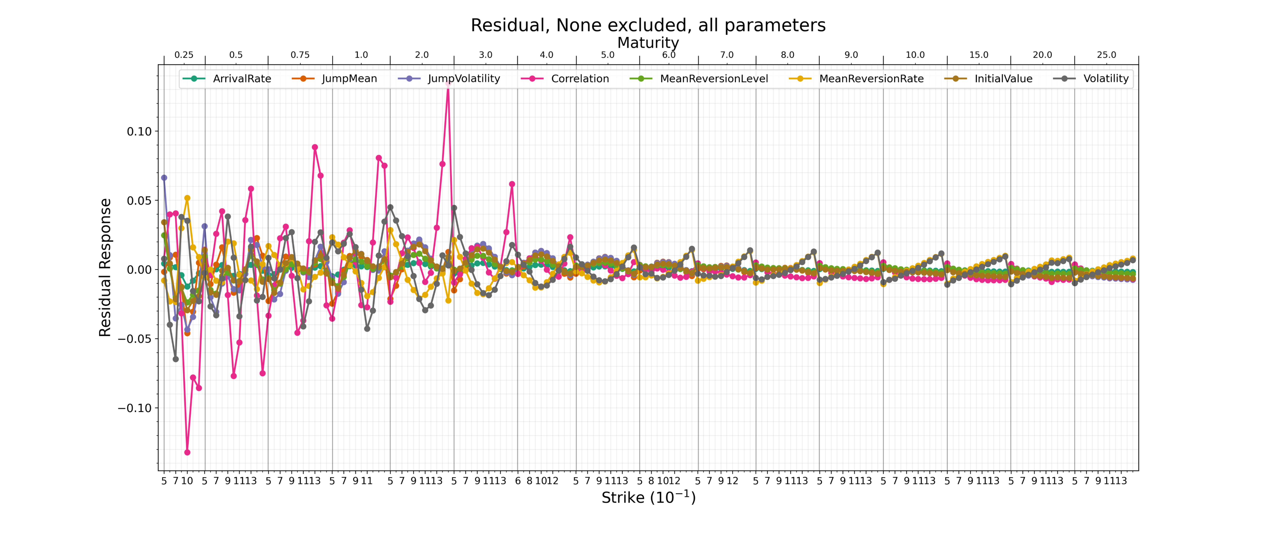

Slide 38
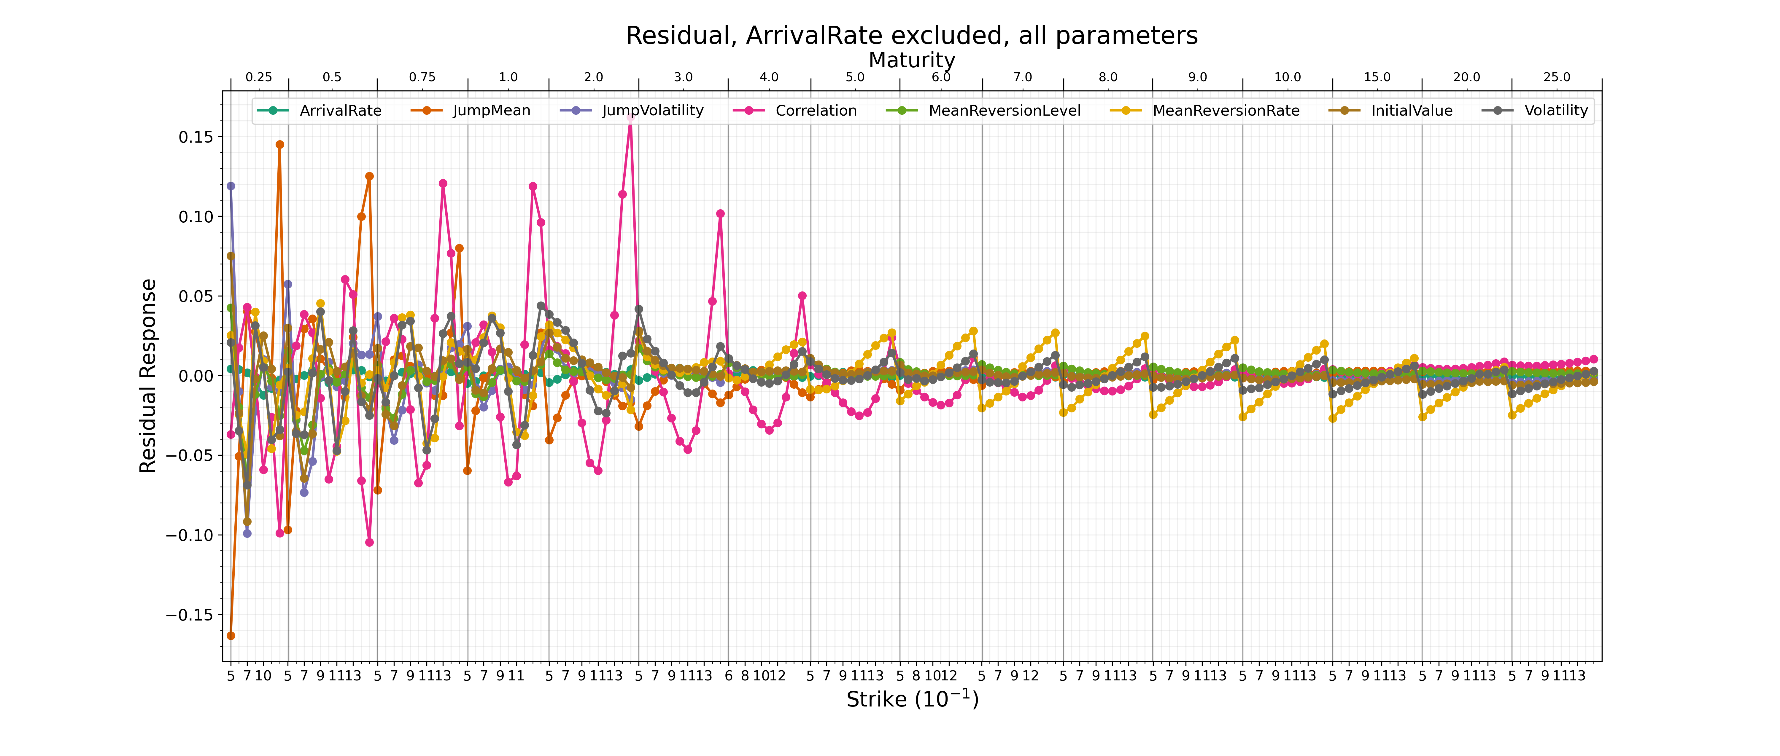

Slide 39
Merton Jump Stochastic Differential equations
The discontinuous process is a Merton jump model:
$dlnS^{JD}\left(t\right)=−λ\overline{μ}dt+ln⁡(J) dN(t)$, where $dN\left(t\right)=N\left(t+dt\right)−N(t)$
where $\overline{μ}=\exp\left(μ_{J}+\frac{1}{2}σ_{J}^{2}\right)−1$ and $J$ is a log-normal distributed random jump value such that $\ln{J}\sim N\left(μ_{J}, σ_{J}^{2}\right).$ The number of random jumps $N\left(t\right)$ that occur over the period $[0,t]$ is determined by a Poisson process with parameter $λt$, where $λ$ is the jump arrival rate (the expected number of jumps per unit time). The Merton jump model can be written in the form:
$λ$ is the jump arrival rate,
$μ_{J}$is the jump mean,
$σ_{J}^{2}$is the jump variance.
$\frac{dS^{JD}\left(t\right)}{S^{JD}(t_)}=−λ\overline{μ}dt+(J −1) dN(t)$,
where $S^{JD}\left(t_\right)=\lim_{t→t_}{S^{JD}(t)}$.

Slide 40
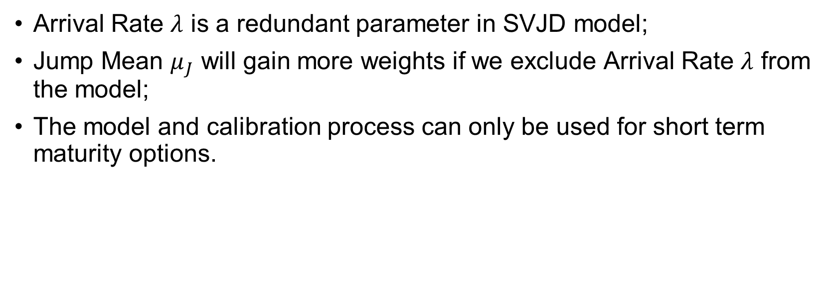
Conclusion:
Arrival Rate $λ$ is a redundant parameter in SVJD model;
Jump Mean $μ_{J}$ will gain more weights if we exclude Arrival Rate $λ$ from the model;
The model and calibration process can only be used for short term maturity options.

Slide 41
Reference:
[1] Black-scholes model. https://www.investopedia.com/terms/b/blackscholes.asp. Accessed: 2022-08-15. [2] Why granular data is essential for climate risk insights. https://capitalmonitor.ai/partner- content/climate-risk-insights-granular-data-essential/. Accessed: 2022-08-22. [3] M. Analytics. Stochastic volatility jump diffusion market consistent calibration methodol-ogy. Available at barrie+hibbert, 2013. [4] M. Analytics. Stochastic volatility jump diffusion model definition. Available at bar-rie+hibbert, 2013. [5] M. Analytics. Calibration tools methodology guide. Available at barrie+hibbert, 2019. [6] M. Analytics. 9.7.2 - scenario generator - developer guide. Available at barrie+hibbert,2021. [7] M. Analytics. 9.8.0 - scenario generator - configuration guide. Available at barrie+hibbert,2022. [8] M. Analytics. 9.8.0 - scenario generator - methodology guide. Available at barrie+hibbert,2022. [9] D. S. Bates. Jumps and stochastic volatility: Exchange rate processes implicit in deutschemark options. The Review of Financial Studies, 9(1):69–107, 1996. [10] F. Black and M. Scholes. The pricing of options and corporate liabilities. The Journal ofPolitical Economy, 81(3):637–654, 1973. [11] J. C. Bogle. Black monday and black swans. Financial Analysts Journal, 64(2):30–40, 2008. [12] D. J. Cole. Parameter redundancy and identifiability. Chapman and Hall/CRC, 2020. [13] R. Cont and P. Tankov. Financial modelling with jump processes. Chapman and Hall/CRC,2004. [14] J. C. Cox, J. E. Ingersoll, and S. A. Ross. A theory of the term structure of interest rates.Econometrica, 53(2):385–407, 1985. [15] R. Craine, L. A. Lochstoer, and K. Syrtveit. Estimation of a stochastic-volatility jump-diffusion model. Revista de Analisis Economico, 15(1):61–87, 2000. [16] B. Dumas, J. Fleming, and R. E. Whaley. Implied volatility functions: Empirical tests.The Journal of Finance, 53(6):2059–2106, 1998. [17] F. Fang and C. W. Oosterlee. A novel pricing method for european options based onfourier-cosine series expansions. SIAM Journal on Scientific Computing, 31(2):826–848,2008. [18] D. Filipovi ́c. Term-structure models: A graduate course. Springer Science & BusinessMedia, 2009. [19] J. Gatheral. The volatility surface: A practitioner’s guide. John Wiley & Sons, 2006. [20] S. L. Heston. A closed-form solution for options with stochastic volatility with applicationsto bond and currency options. The review of financial studies, 6(2):327–343, 1993. [21] J. Hull and A. White. The pricing of options on assets with stochastic volatilities. Thejournal of finance, 42(2):281–300, 1987.34
[22] M. Kemp. Market consistency: model calibration in imperfect markets. John Wiley & Sons,2009. [23] Y. K. Kwok, K. S. Leung, and H. Y. Wong. Efficient options pricing using the fast fouriertransform. In Handbook of computational finance, pages 579–604. Springer, 2012. [24] A. L. Lewis. A simple option formula for general jump-diffusion and other exponential l ́evyprocesses. Available at SSRN 282110, 2001. [25] K. Madsen, H. B. Nielsen, and O. Tingleff. Methods for non-linear least squares problems.2004. [26] B. Mandelbrot. The variation of some other speculative prices. The Journal of Business,40(4):393–413, 1967. [27] R. N. S. A. d. Matos. Stochastic volatility jump-diffusion models as time-changed L ́evyprocesses. PhD thesis, 2014. [28] T. M ́atrai and I. Naish-Guzm ́an. Revisiting the lmm+ model. Available at barrie+hibbert,2013. [29] B. Øksendal. Stochastic differential equations: An introduction with applications. SpringerScience & Business Media, 1998. [30] J. Pan. The jump-risk premia implicit in options: Evidence from an integrated time-seriesstudy. Journal of financial economics, 63(1):3–50, 2002. [31] S. Pourghanbar and M. Ranjbar. From itˆo and stratonovich to black-scholes. 2016. [32] E. M. Stein and J. C. Stein. Stock price distributions with stochastic volatility: An analyticapproach. The review of financial studies, 4(4):727–752, 1991. [33] H. R. Stoll. The relationship between put and call option prices. The Journal of Finance,24(5):801–824, 1969. [34] S. Vikberg and J. Bj ̈orkman. How well does implied volatility predict future stock indexreturns and volatility?: A study of option-implied volatility derived from omxs30 index options, 2020. [35] P. Wilmott. Derivatives: The theory and practice of financial engineering. Wiley, 1998. [36] J. Zhu. Applications of Fourier transform to smile modeling: Theory and implementation. Springer Science & Business Media, 2010.

Slide 42
Thanks!
More Question…

